Slide 1

“The Dead”
Final Discussion on Joyce’s Dubliners

Slide 2
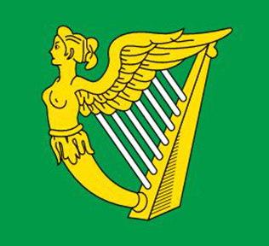
Irish Nationalism
The United Irishmen used this flag in their early rebellions against the British—it was used from 18th -20th centuries by Irish Nationlists
Note the harp…Consider the imagery in “Araby” and “Two Gallants” along with Joyce’s consistent use of music in his stories

Slide 3
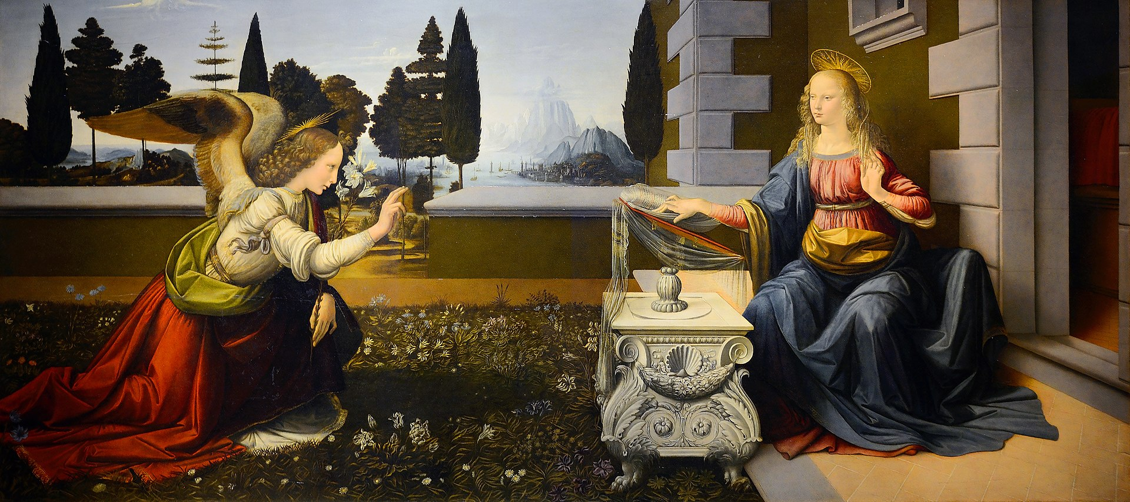
Archangel Gabriel
Leonard da Vinci’s “Annunciation” (1472-75) depicts Gabriel acting as a messenger for God—he tells Virgin Mary that she will conceive and give birth to the “Son of God”

Slide 5
Reminder on Epiphany
Joyce adopted a religious word – epiphany. The epiphany (meaning ‘manifestation’) was originally the episode in the Christian story when the wise men first saw the infant Jesus: the moment is the first showing of the divine within the world, which is its new home: Joyce takes that thought, but he relocates its spirituality wholly within the frame of the mundane. In his abandoned novel Stephen Hero, which he wrote alongside the short stories, he has Stephen, his spokesman, explain: ‘By an epiphany he meant a sudden spiritual manifestation, whether in the vulgarity of speech or of gesture or in a memorable phase of the mind itself’. The theory sponsors an artistic vocation: ‘He believed that it was for the man of letters to record these epiphanies with extreme care, seeing that they themselves are the most delicate and evanescent of moments’.
Epiphany is recognized officially on January 6th by the Catholic Church (also known as Three Kings Day)
Keep this date in mind when you think of WHEN “The Dead” occurs

Slide 6
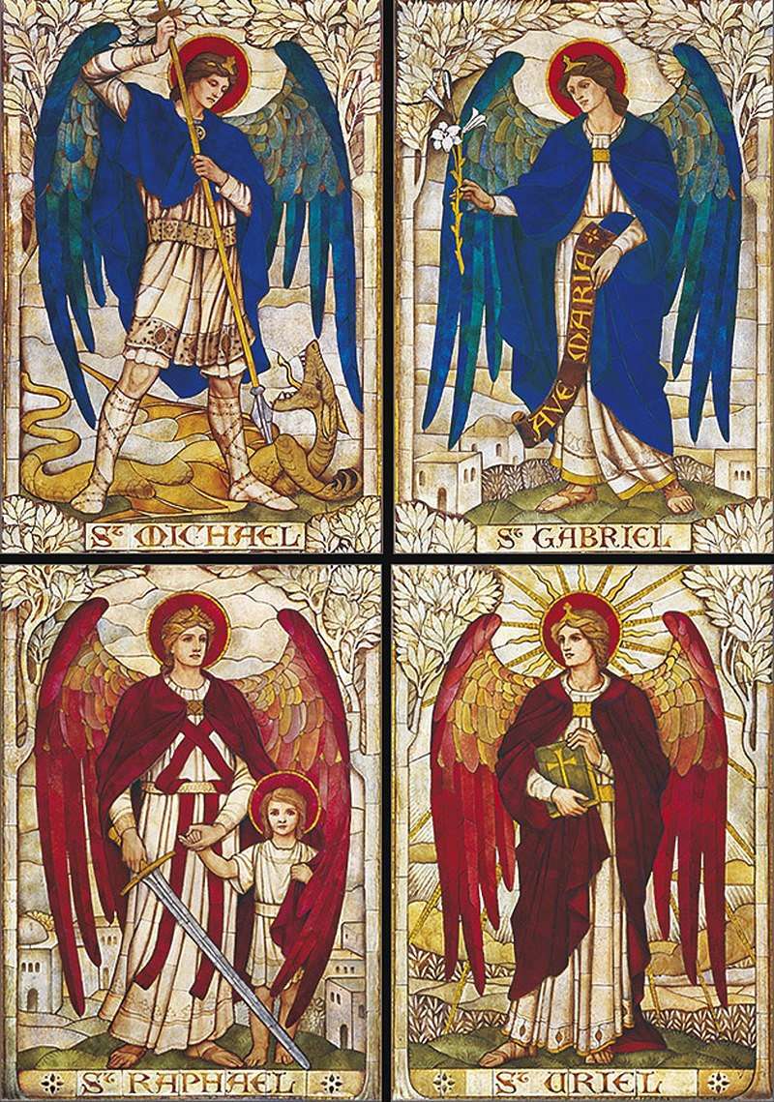
Archangels
Gabriel and Michael would be known by Joyce (and Catholics) as archangels—the highest ranking angels who served God as messengers and fighters
Gabriel is typically associated with a lily and/or a trumpet and is more associated with communication/messages from God
Michael is typically associated with a sword as he is known to be God’s greatest warrior

Slide 7
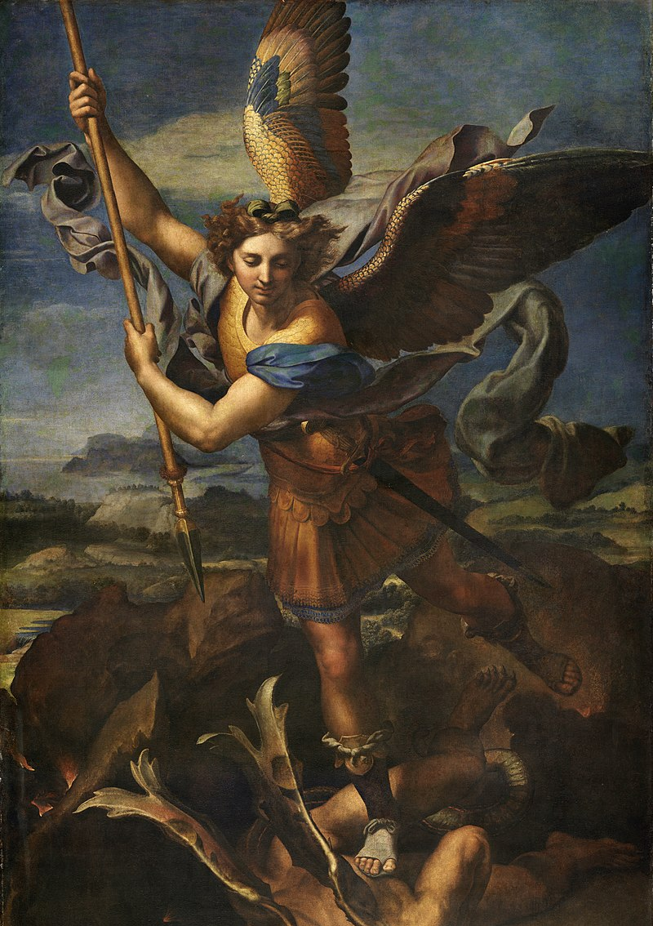
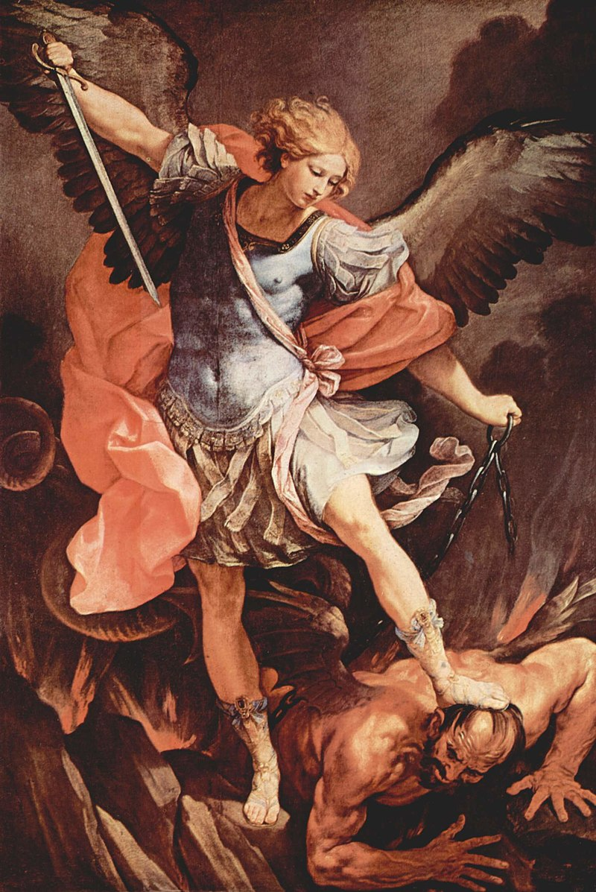
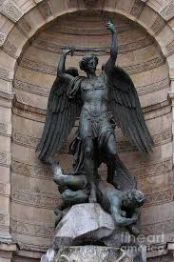
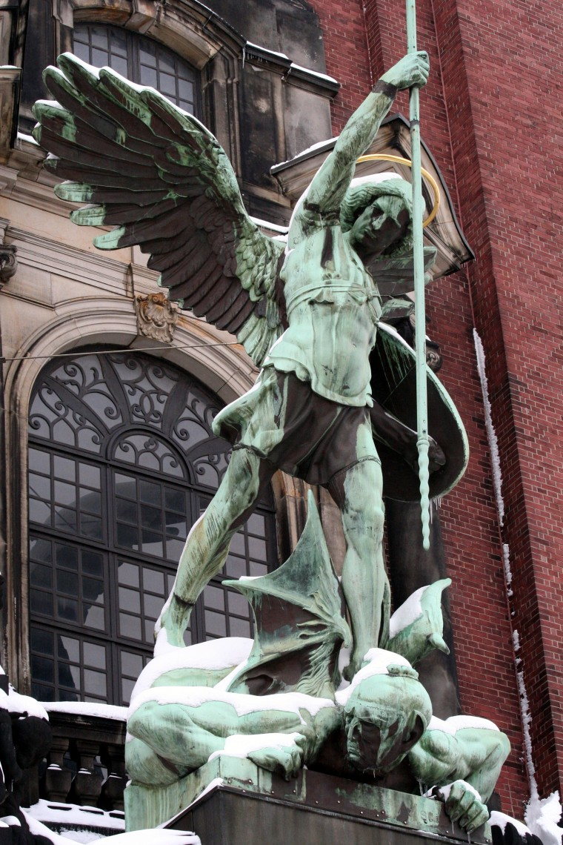
Michael

Slide 8
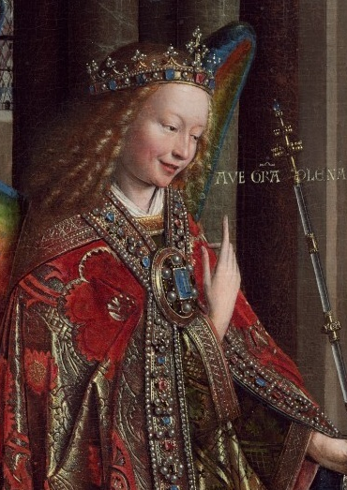
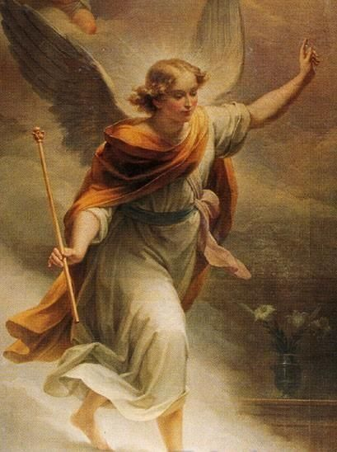
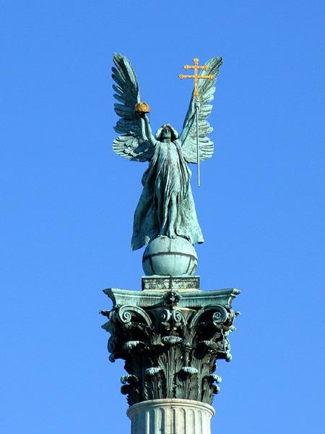
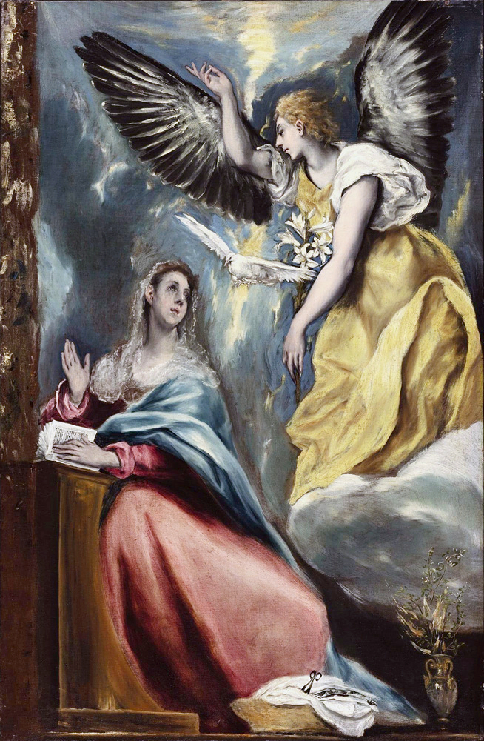
Gabriel

Slide 9

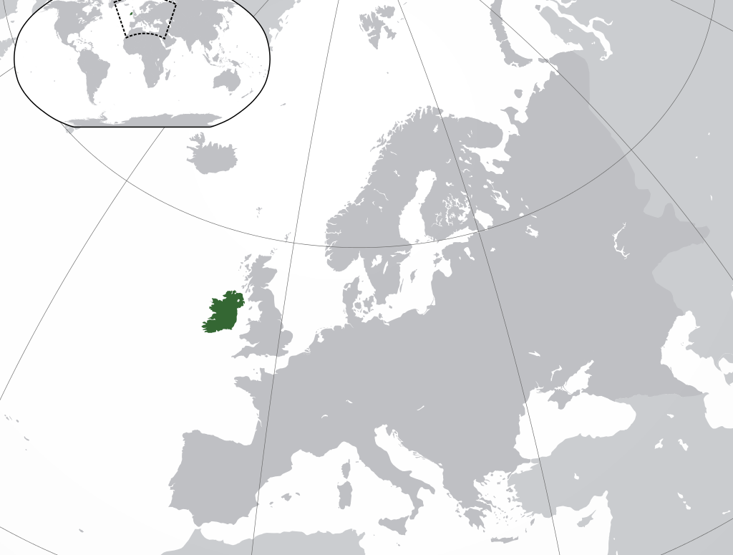
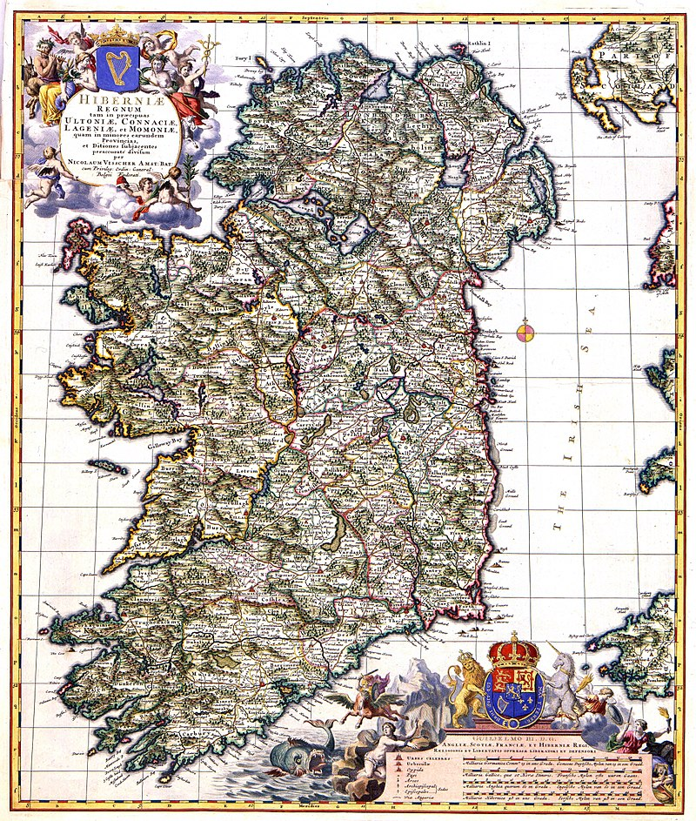
Questions to Consider: 1. How would you describe Gabriel Conroy’s attitude towards Ireland? 2. What (and where) is Gabriel’s epiphany? 3. Does any other character in “The Dead” have an epiphany?

Slide 10
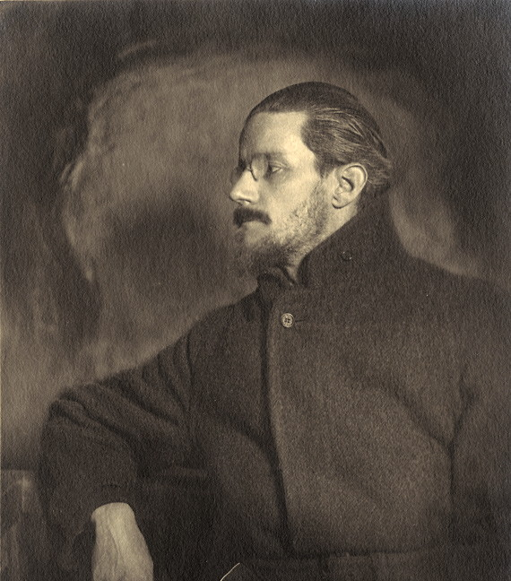
James Joyce on “paralysis” in Ireland Joyce’s Dublin, a city that he professed to love, but ‘a city of the living dead’ is the dark milieu accentuating the paralysis of its inhabitants throughout all the stories in Dubliners, “The word paralysis was both an epigraph and an epitaph for its spiritual moribundity.” Paralysis as a metaphor rather than a literal term What characters do you see as unmoving, unchangining, trapped in some way?

Slide 11
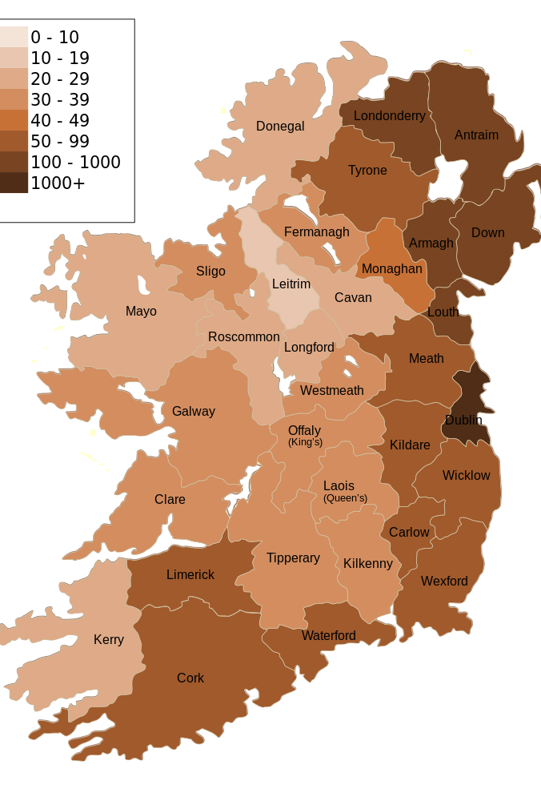
Galway and Dublin
Why is Galway important in “The Dead”?
Who wants to go? Who is from that area?
Galway was (and still is) associated with old Ireland, with traditions, and with the language Irish

Slide 12
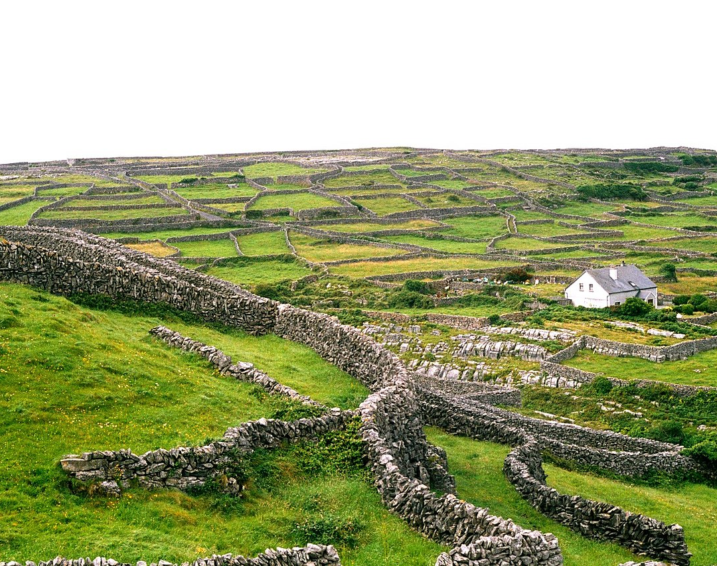
Quiz
Who mocks Gabriel for being a “West Briton” while dancing with him?
What does Gabriel choose to eat instead of sweet desserts?
What is Gabriel’s realization at the end of the story?
What causes Gretta to remember Michael Furey?
Extra Credit
What are the names of Gabriel’s aunts?
What concrete image (object) do you notice in the “The Dead” and two of the three other stories we have read this semester?

